Slide 1

Bee Space
“Earth is the cradle of humanity,
but one cannot live in a cradle forever. ”

Slide 2

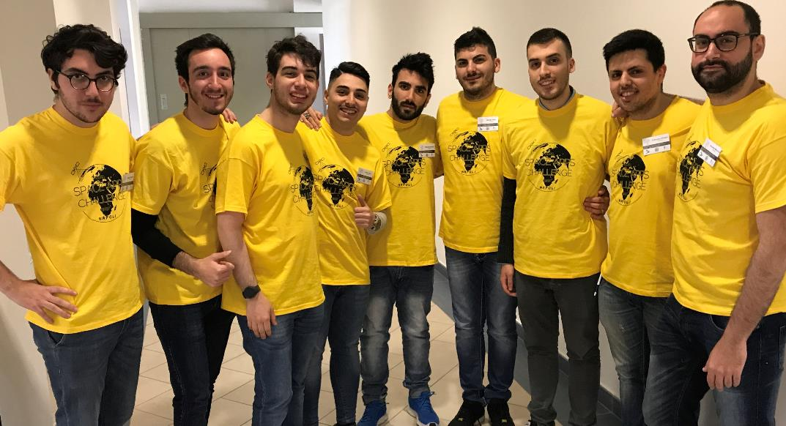
The team
Daniele Del Guercio
Alessio Ianniello
Davide Mango
Alessandro Martucci
Antonio Minutillo
Armando Mocerino
Francesco Perrelli
Andrea Raia
Davide Testa

Slide 3
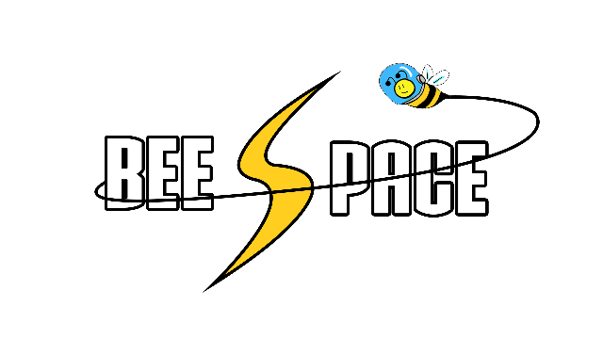
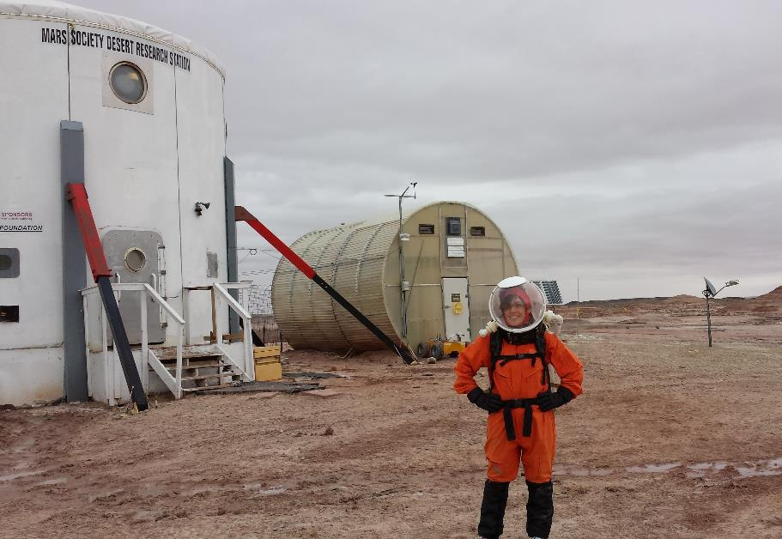
The challenge:
Small Spaces, Big Ideas!
Many tests have already been realized on Earth to simulate an extraterrestrial environment.
Examples of this experiments are:
MDRS (Mars Desert Research Station)
- Hi-Seas

Slide 4
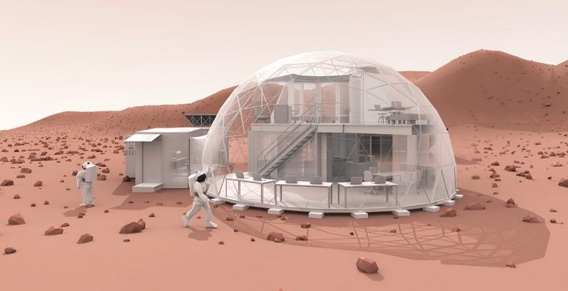
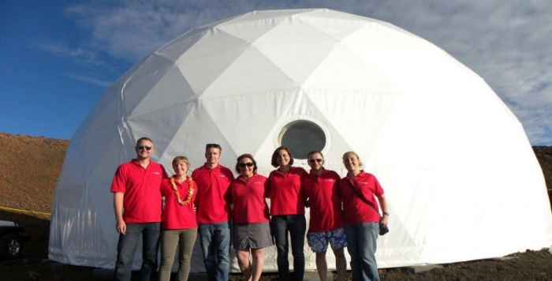
Hi-Seas
HI-SEAS (Hawai’i Space Exploration Analog and Simulation) is a Habitat on an isolated Mars-like site.
Its limits:
- unoptimized layout
- difficult to remodulate or extend
- low index of liveability

Slide 5
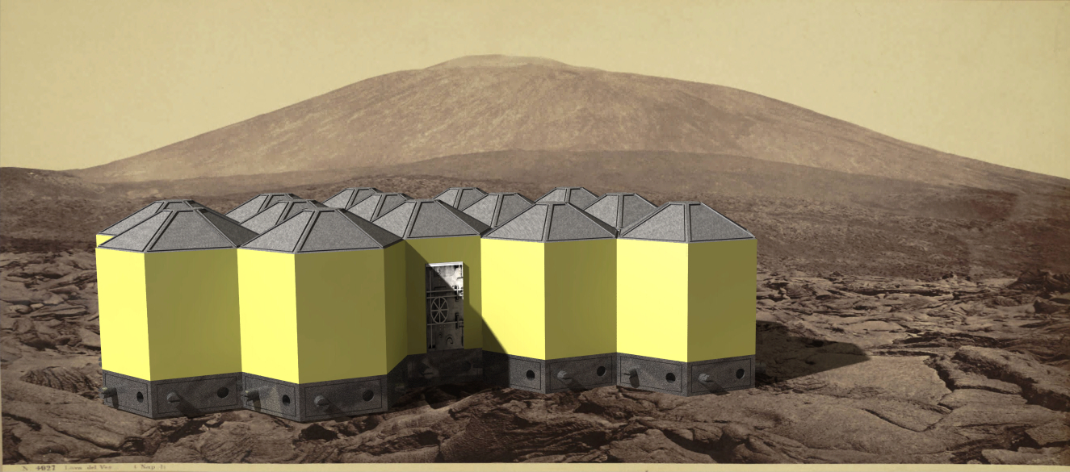
Our proposal is:
H.O.M.E. Lab
(Hexagonal Open Modular Environment)

Slide 6
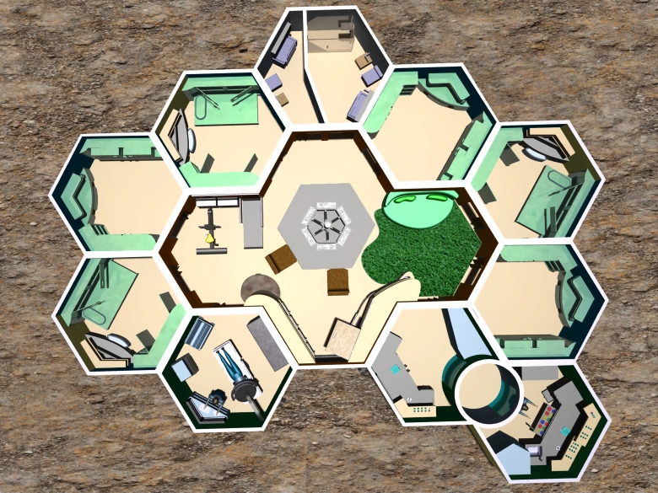
H.O.M.E. Lab
A hneycomb-structure hab, divided into different hexagonal compartment modules.
1-6: rooms
7: labs
8: clinic room
9: bathrooms
10: open space
9
3
4
5
2
(kitchen, living room, relax room)
1
10
6
8
7

Slide 7
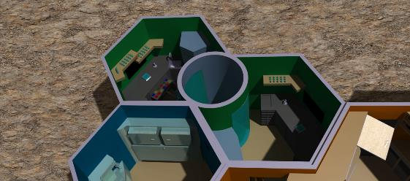
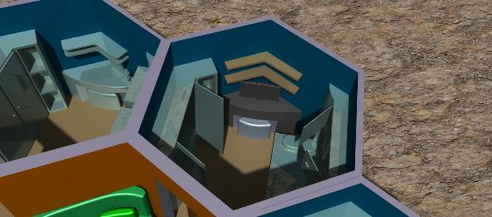
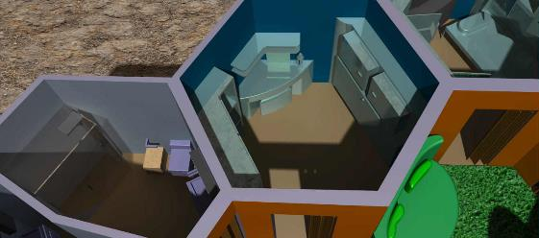
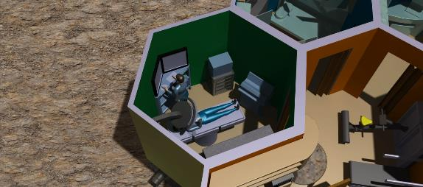
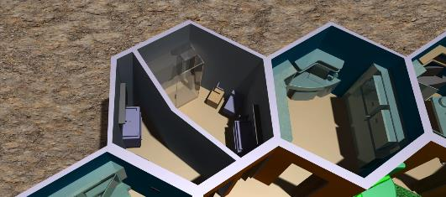
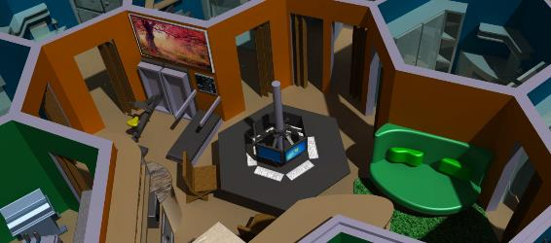
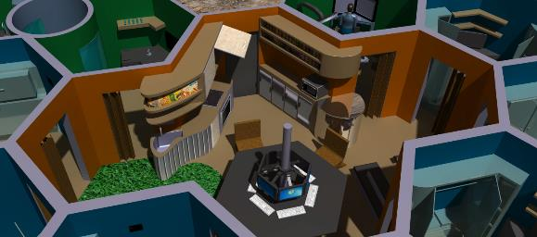
H.O.M.E. Lab
Lab
A honeycomb-structure hab, divided into different hexagonal compartment modules.
Room (open)
Room (closed)
Clinic room
Bathroom
Living room
Living room

Slide 8
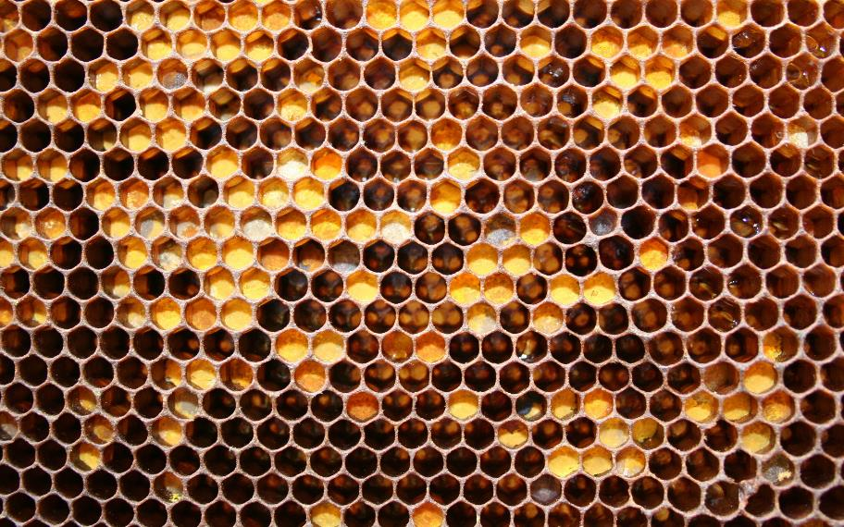
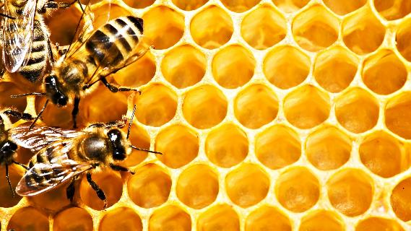
The hexagonal cell
As nature shows, the hexagonal cell allows bees:
to save building material
To maximize space.

Slide 9

The hexagonal cell
Cell basic elements: angle bracket, panels and roof
- Cell configuration - Generical assembly

Slide 10
Layout flexibility
This layout makes it possible:
- to add new cells
- to organize the lab disposition according to the users necessity

Slide 11
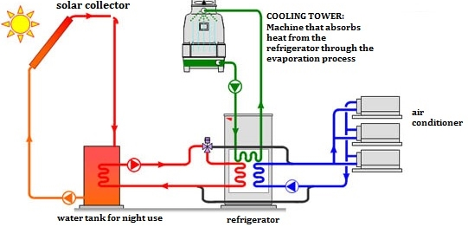
Environmental sustainability
Solar panels for electrical sustainability and for solar cooling
Bike-washing machine
Waste management:
- Waste disposal compactor
- UPA (Urin Processing Assembly) from ISS,

Slide 12
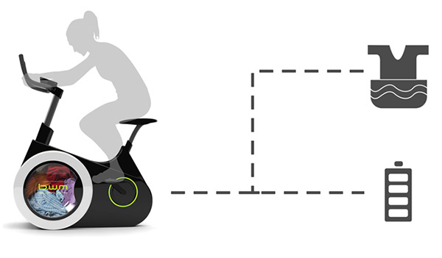
Environmental sustainability
Solar panels for electrical sustainability and for solar cooling
Bike-washing machine
Waste management:
- Waste disposal compactor
- UPA (Urin Processing Assembly) from ISS,

Slide 13
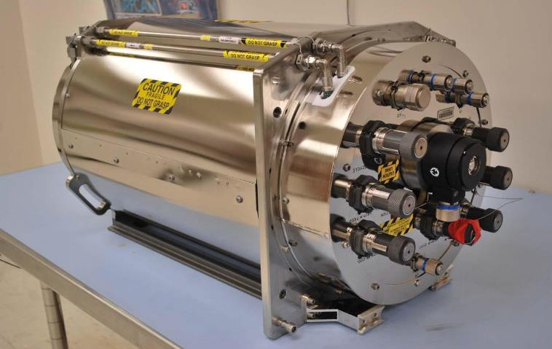
Environmental sustainability
Solar panels for electrical sustainability and for solar cooling
Bike-washing machine
Waste management:
- Waste disposal compactor
- UPA (Urin Processing Assembly) from ISS,

Slide 14
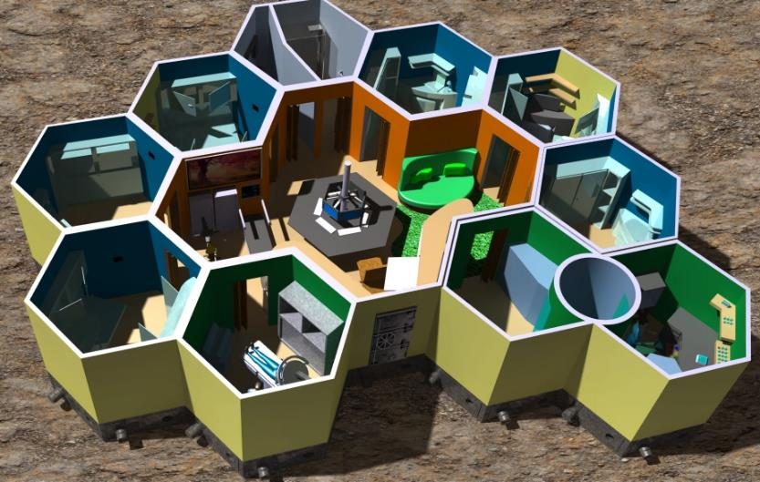
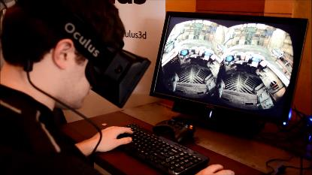
User-friendly environment
Our environment is designed to prevent psychological stress in the crew:
- rooms with different functions painted with specific colors
- background music
- round shape
- pet therapy
- Virtual Space Station (psyhcological data monitoring)
- VR viewer for playful purpose
- physical exercise and data monitoring

Slide 15
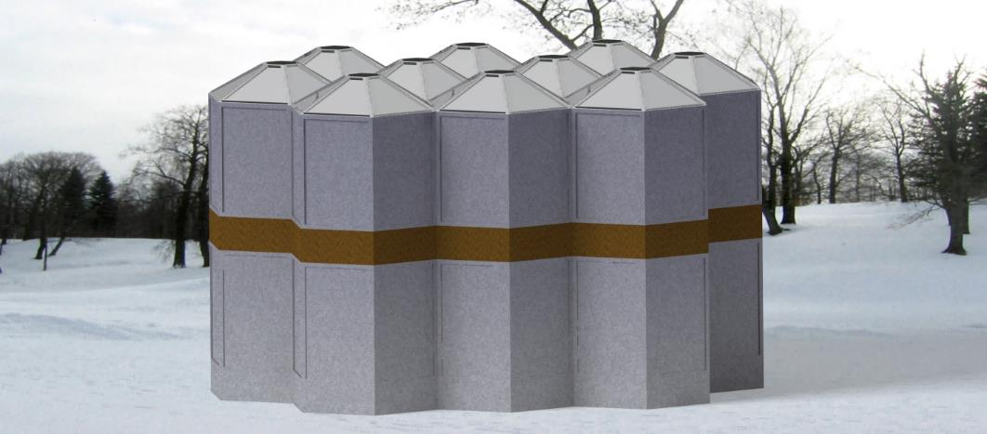
Further developments
Civil applications:
Sustainable Development Goals (SDGs), adopted by the United Nations General Assembly, for:
- Goal 11.1: by 2030, adequate, safe and affordable housing for everyone
- Goal 11.3: by 2030, integrated and sustainable human settlement

Slide 16
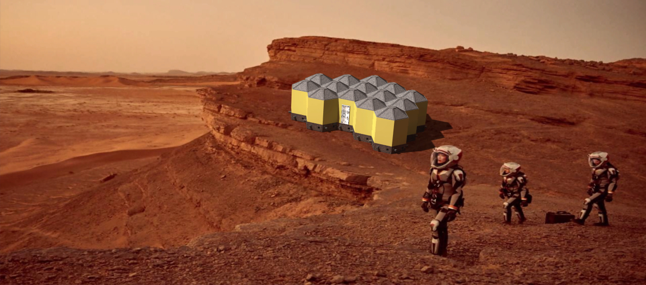
Next stop: Mars

Slide 17
Thank you for your attention!

